Slide 1
Chapter 11
Sections 11.11, 11.12, 11.13
Arraylists

Slide 2
The ArrayList Class
You can create an array to store multiple objects. But the array’s size is fixed once the array is created.
Java provides the ArrayList class that can be used to store an unlimited number of objects. You do not specify a size when creating an ArrayList object.
To use ArrayList you will need to do the following import:
import java.util.ArrayList;

Slide 3

The ArrayList Class
The following figure shows some of the methods in ArrayList class. We will be using many of these methods in our example in the next few slides.

Slide 4
The ArrayList Class
Syntax to create an arraylist object:
ArrayList<ObjectType> <listName> = new ArrayList<>();
For instance, to create an arraylist object “cityList” to hold city names:
ArrayList<String> cityList = new ArrayList<>();

Slide 5
The ArrayList Class - add
// Add some cities in the list using the add method
cityList.add("London");
// cityList now contains [London]
cityList.add("Denver");
// cityList now contains [London, Denver]
cityList.add("Paris");
// cityList now contains [London, Denver, Paris]

Slide 6
The ArrayList Class - add
cityList.add("Miami");
// cityList now contains [London, Denver, Paris, Miami]
cityList.add("Seoul");
// contains [London, Denver, Paris, Miami, Seoul]
cityList.add("Tokyo");
// contains [London, Denver, Paris, Miami, Seoul, Tokyo]

Slide 7
The ArrayList Class - size
System.out.println("List size? " + cityList.size());
// displays 6 since there are 6 city names in the list

Slide 8
The ArrayList Class - contains
System.out.println(cityList.contains("Miami"));
//Displays true since Miami is in the list

Slide 9
The ArrayList Class - indexOf
System.out.println(cityList.indexOf("Denver"));
//Displays 1 since the index of Denver is 1 in the list

Slide 10
The ArrayList Class - isEmpty
System.out.println(cityList.isEmpty());
// Displays false since the list is not empty

Slide 11
The ArrayList Class - add
// Insert a new city at index 2
cityList.add(2, "Xian");
// contains [London, Denver, Xian, Paris, Miami, Seoul, Tokyo]

Slide 12
The ArrayList Class - remove
// Remove a city from the list
cityList.remove("Miami");
// contains [London, Denver, Xian, Paris, Seoul, Tokyo]

Slide 13
The ArrayList Class - remove
// Remove a city at index 1
cityList.remove(1);
// contains [London, Xian, Paris, Seoul, Tokyo]

Slide 14
The ArrayList Class - toString
// Display the contents in the list
System.out.println(cityList.toString());

Slide 15
The ArrayList Class - loop
// Display the contents in the list
for (int i = 0; i < cityList.size() ; i++)
System.out.print(cityList.get(i) + " ");

Slide 16
Entire Code
import java.util.ArrayList;
public class TestArrayList {
public static void main(String[] args) {
// Create a list to store cities
ArrayList<String> cityList = new ArrayList<>();
// Add some cities in the list
cityList.add("London");
// cityList now contains [London]

Slide 17
Entire Code
cityList.add("Denver");
// cityList now contains [London, Denver]
cityList.add("Paris");
// cityList now contains [London, Denver, Paris]
cityList.add("Miami");
// cityList now contains [London, Denver, Paris, Miami]
cityList.add("Seoul");
// contains [London, Denver, Paris, Miami, Seoul]
cityList.add("Tokyo");
// contains [London, Denver, Paris, Miami, Seoul, Tokyo]

Slide 18
Entire Code
System.out.println("List size? " + cityList.size());
System.out.println("Is Miami in the list? " +
cityList.contains("Miami"));
System.out.println("The location of Denver in the list? "
+ cityList.indexOf("Denver"));
System.out.println("Is the list empty? " +
cityList.isEmpty()); // Print false

Slide 19
Entire Code
// Insert a new city at index 2
cityList.add(2, "Xian");
// contains [London, Denver, Xian, Paris, Miami, Seoul, Tokyo]
// Remove a city from the list
cityList.remove("Miami");
// contains [London, Denver, Xian, Paris, Seoul, Tokyo]
// Remove a city at index 1
cityList.remove(1);
// contains [London, Xian, Paris, Seoul, Tokyo]

Slide 20
Entire Code
// Display the contents in the list
System.out.println(cityList.toString());
// Display the contents in the list in reverse order
for (int i = 0; i < cityList.size() ; i++)
System.out.print(cityList.get(i) + " ");
System.out.println();
}
}

Slide 21
Exercise 1
How do you do the following?
a. Create an ArrayList called list for storing double values?
b. Append 2.5 to the list?
c. Insert 3.5 at the beginning of the list?
d. Find the number of objects in the list?
e. Remove 2.5 from the list?
f. Remove the last object from the list?
g. Check whether 3.5 is in the list?
h. Retrieve the object at index 1 from the list?

Slide 22
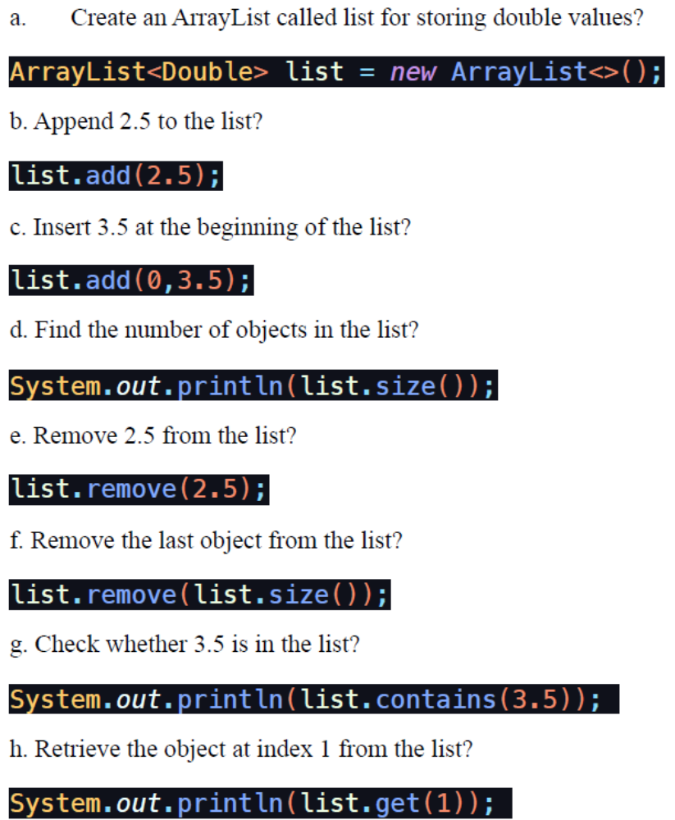
Exercise 1 Solutions

Slide 23
Exercise 2
a. Explain why the following code displays [1, 3] rather than [2, 3].
  ArrayList<Integer> list = new ArrayList<>();
  list.add(1);
  list.add(2);
  list.add(3);
  list.remove(1);
  System.out.println(list);
b. How do you remove integer value 3 from the list?

Slide 24
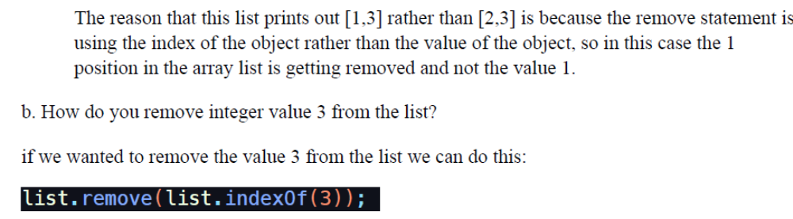
Exercise 2 Solutions

Slide 25
Exercise 3
Run the code from slides 16-20 on Netbeans and submit a snapshot of the output

Slide 26
Array Lists fromArrays
Creating an ArrayList from an array of objects:
Suppose the following array is given:
String[] array = {“covid-19", “sars", “hiv"};
This array can easily be converted to an ArrayList by using the asList method from the Arrays class as shown below:
ArrayList<String> list = new ArrayList<>(Arrays.asList(array));
Now, list is an ArrayList with the three values – covid-19, sars and hiv.

Slide 27
Array Lists to Arrays
Creating an array of objects from an ArrayList:
Let’s say that we already have an arraylist called list that stores the values covid-19, sars and hiv.
We can simply use toArray method from the ArrayList class to create an array as shown below:
String[] array1 = new String[list.size()];
list.toArray(array1);
This creates an array “array1” with length equal to the size of the ArrayList list and holds the content of the list.

Slide 28
Collections Class
There is a Collections class in Java that provides us with several methods that can be used on an ArrayList object.
We will next look at few of these methods from the Collections class.
All these methods on the next slide are self-explanatory but do let me know, if you have any questions. Make sure to run them and see the results.

Slide 29
Some methods from Collection Class
java.util.ArrayList<Integer> list = new java.util.ArrayList<>();
list.add(10);
list.add(30);
list.add(40);
list.add(10);
System.out.println(list);
System.out.println(java.util.Collections.max(list));
System.out.println(java.util.Collections.min(list));
System.out.println(java.util.Collections.frequency(list, 10));
java.util.Collections.shuffle(list);
System.out.println(list);
java.util.Collections.sort(list);
System.out.println(list);

Slide 30

Case Study: The MyStack Class
Next, we will look at a program where we design a stack class to hold Integer objects.
Following is the UML Class diagram.

Slide 31
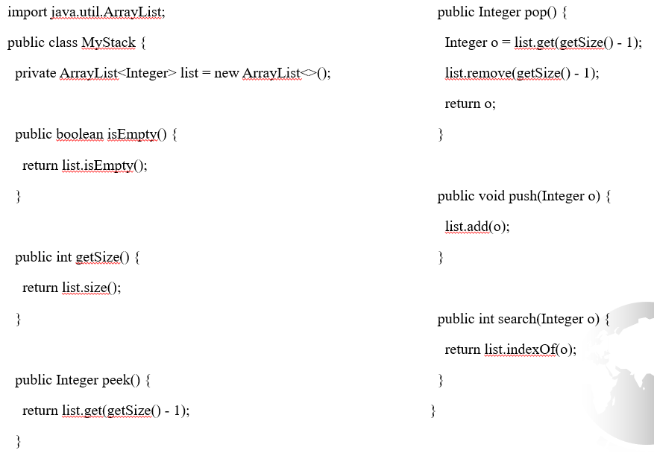
Case Study: The MyStack Class

Slide 32
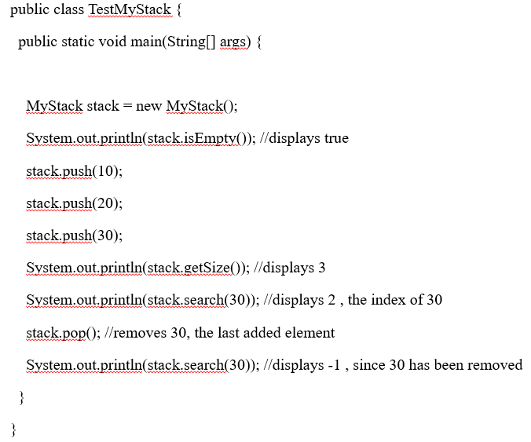
Case Study: The Main Class

